Slide 1
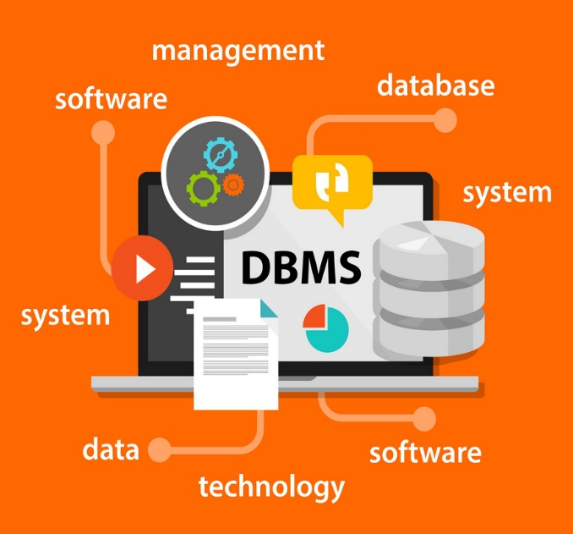
Overview and Architecture of Database Systems:
Unit-1
Sources: Reference Book, NPTEL website, Internet

Slide 2

Looping
Outline
Introduction of DBMS
Applications of DBMS
Advantages of DBMS
Three levels ANSI SPARC database system
Data Abstraction in DBMS
Mappings and data independence
Database users and DBA
Database system architecture

Slide 3
Introduction to DBMS
Section - 1

Slide 4
What is Database Management System (DBMS)?
Data - Fact that can be recorded or stored
e.g. Person Name, Age, Gender and Weight etc.
Database - Collection of logically related data
e.g. Books Database in Library, Student Database in University etc.
Management - Manipulation, Searching and Security of data
e.g. Viewing result in college website, Searching exam papers in college website etc.
System - Programs or tools used to manage database
e.g. SQL Server Studio Express, Oracle etc.
DBMS - A Database Management System is a software for creating and managing databases.
Database Management System (DBMS) is a software designed to define, manipulate, retrieve and manage data in a database.
e.g. MS SQL Server, Oracle, My SQL, SQLite, MongoDB etc.

Slide 5
Applications of DBMS
Section - 2

Slide 6
Applications of DBMS
DBMS is a computerized record-keeping system.
DBMS is required where ever data need to be stored.
E-Commerce (Flipkart, Amazon, Shopclues, eBay etc...)
Online Television Streaming (Hotstar, Amazon Prime etc...)
Social Media (WhatsApp, Facebook, Twitter, LinkedIn etc...)
Banking & Insurance (all transactions, customers detail, loan detail, debit, credit etc..)
Airline & Railway (reservations, schedules, customers detail, etc..)
Universities and Colleges/Schools (registration, grades, student detail, employee detail, etc..)
Library Management System (Book details, its location, Borrower detail, etc.. )
Human Resource Department (employee records, salaries, tax deductions, etc..)
Hospitals and Medical Stores ( Patient detail, doctor details, employee, drug details, rooms detail, etc..)
Government Organizations (Adhaar, PAN, voter detail, rashan card, govt. schemes, etc..)
Manufacturing (production, inventory, orders, supply chain, etc..)
Exercise
Write down any five applications of DBMS other than above.

Slide 7
Advantages of DBMS
Drawback of file system

Slide 8

Data redundancy (duplication)
Computer
Civil
Emp_Name | Address | Mobile | Subject
Emp_Name | Address | Mobile | Subject
Prof. Sharma | Ahmedabad | 1234 | Mgmt
Prof. Sharma | Ahmedabad | 1234 | Mgmt
Database management system can remove such data redundancy by storing data centrally.
Same data is stored at
four different places.
Emp_Name | Address | Mobile | Subject
Emp_Name | Address | Mobile | Subject
Prof. Sharma | Ahmedabad | 1234 | Mgmt
Prof. Sharma | Ahmedabad | 1234 | Mgmt
Electrical
Mechanical

Slide 9
Data inconsistency
Computer
Civil
Emp_Name | Address | Mobile | Subject
Emp_Name | Address | Mobile | Subject
6789
Prof. Sharma | Ahmedabad | 1234 | Mgmt
Prof. Sharma | Ahmedabad | 1234 | Mgmt
Database management system can keep data in consistent state.
Same data having
different state (values)
Mobile no is changed
Emp_Name | Address | Mobile | Subject
Emp_Name | Address | Mobile | Subject
6789
Prof. Sharma | Ahmedabad | 1234 | Mgmt
Prof. Sharma | Ahmedabad | 1234 | Mgmt
Electrical
Mechanical

Slide 10
Data isolation
Data are scattered in various files.
Files may be in different formats.
Difficult to retrieve the appropriate data.
File - 1
Emp_Name | Address | Mobile | Subject
Prof. Sharma | Ahmedabad | 1234 | Mgmt
DBMS allow us to access (retrieve) appropriate data easily.
File - 2
Emp_Name | Post | Salary | Load
Prof. Sharma | Lecturer | 50,000 | 16 Hrs
Data isolation is a property that determines when and how changes made by one operation become visible to other concurrent users and systems.
This issue occurs in a concurrency situation.
File - 3
Emp_Name | Teaching | Knowledge | Rating
Prof. Sharma | Good | Excellent | 9

Slide 11


Atomicity
Atomicity: Either transaction execute 0% or 100%.
Failures may leave database in an inconsistent state with partial updates carried out(changing some file content and power off)
E.g. transfer of funds from one account to another should either complete or not happen at all
Sum of both account before transfer is 3000
Person A
Account A
Bal : 2000
Transfer 500
Person B
Account B
Bal : 1000
Step 1 : Debit 500 from Account A
Step 2 : Credit 500 into Account B
Transaction is failed
Sum of both account is 2500
so inconsistent
Sum of both account
after transfer is 3000

Slide 12
Allow to implement integrity constraints
Emp_Name | Address | Mobile_No | Subject
Prof. Sharma | Ahmedabad | 9876543210 | Mgmt
Should contain exact 10 digits
Student_Name | Branch | Backlog | CGPA
Arpit | CSE | 0 | 8.5
Should be between 0 to 10
DBMS allows us to implement such business rules in our database..

Slide 13

Sharing of data among multiple users(Concurrency)
Want to access
Computer
Civil
Emp_Name | Address | Mobile | Subject
Emp_Name | Address | Mobile | Subject
Prof. Sharma | Ahmedabad | 1234 | Mgmt
Prof. Sharma | Ahmedabad | 1234 | Mgmt
Want to access
Database management system allows more than one user to access same data simultaneously.
Emp_Name | Address | Mobile | Subject
Emp_Name | Address | Mobile | Subject
Prof. Sharma | Ahmedabad | 1234 | Mgmt
Prof. Sharma | Ahmedabad | 1234 | Mgmt
Electrical
Mechanical
Concurrent accessed needed for performance
Uncontrolled concurrent accesses can lead to inconsistencies
E.g. two people reading a balance and updating it at the same time

Slide 14

Restricting unauthorized access to data
File - 1
Emp_Name | Address | Mobile | Subject
Prof. Sharma | Ahmedabad | 1234 | Mgmt
Wants to access
Faculty of other college
File - 2
Emp_Name | Post | Salary | Load
Prof. Sharma | Lecturer | 50,000 | 15
Wants to access
Nirma Faculty
File - 3
Emp_Name | Teaching | Knowledge | Rating
Prof. Sharma | Good | Excellent | 9
DBMS prevents unauthorized user to access data.

Slide 15
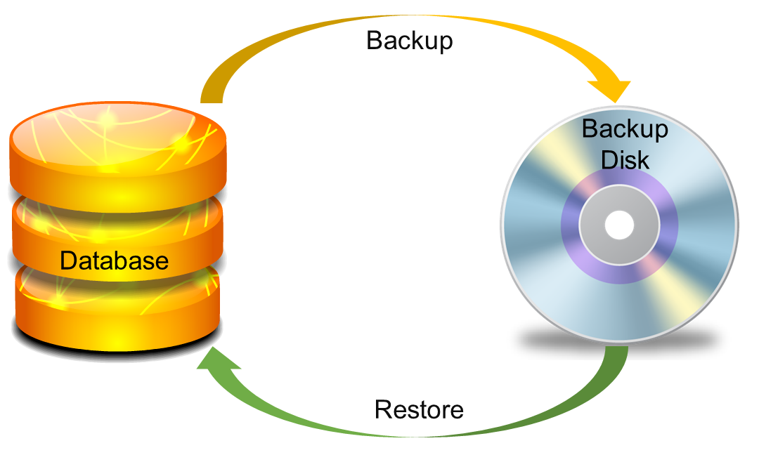
Providing backup and recovery services
Provides facilities to backup and restore the database in case of failure.

Slide 16
Advantages of DBMS (Summary)
Remove data inconsistency: By eliminating redundancy, data inconsistency can be removed.
Data isolation: A user can easily retrieve proper data as per his/her requirement.
Guaranteed atomicity: Either transaction executes 0% or 100%.
Controls database redundancy: It can control data redundancy because it stores all the data in one single database file and that recorded data is placed in the database.
Data sharing: In DBMS, the authorized users of an organization can share the data among multiple users.
Easily Maintenance: It can be easily maintainable due to the centralized nature of the database system.
Reduce time: It reduces development time and maintenance need.
Backup: It provides backup and recovery subsystems which create automatic backup of data from hardware and software failures and restores the data if required.
Allow implementing integrity constraints: Business rules can be implemented such as do not allow to store amount less than Rs. 0 in balance.
Restricting unauthorized access to data: A user can only access data which is authorized to him/her.

Slide 17
Disadvantages
Cost of Hardware and Software: It requires a high speed of data processor and large memory size to run DBMS software.
Size: It occupies a large space of disks and large memory to run them efficiently.
Complexity: Database system creates additional complexity and requirements.(training)
Higher impact of failure: Failure is highly impacted the database because in most of the organization, all the data stored in a single database and if the database is damaged due to electric failure or database corruption then the data may be lost forever.

Slide 18
Basic Terms
Section - 4

Slide 19
Basic terms
Data
Data is raw, unorganized facts that need to be processed.
Example: Marks of students
Student_1 = 50/100, Student_2 = 25/100.
Information
When data is processed, organized, structured or presented in a given context so as to make it useful, it is called information.
Example: Result of students (Pass or Fail)
Student_1 = Pass, Student_2 = Fail.

Slide 20
Basic terms (cont…)
Metadata
Metadata is data about data.
Data such as table name, column name, data type, authorized user and user access privileges for any table is called metadata for that table.
Metadata of above table is:
Table name such as Faculty
Column name such as Emp_Name, Address, Mobile_No, Subject
Datatype such as Varchar, Decimal
Access privileges such as Read, Write (Update)
Faculty
Emp_Name | Address | Mobile_No | Subject
Prof. Sharma | Ahmedabad | 1234 | Mgmt

Slide 21
Basic terms (cont…)
Data dictionary
A data dictionary is an information repository which contains metadata.
Data warehouse
A data warehouse is an information repository which stores historical data.
Table Name – Faculty
Column Name – EmpName, Address, Mob, Subject, Salary
Datatype – Varchar, Decimal
Access Privileges – Read, Write (Update)
Faculty
Emp_Name | Address | Mobile_No | Subject
Prof. Sharma | Ahmedabad | 1234 | Mgmt
Prof. Verma | Ahmedabad | 5678 | DBMS

Slide 22
Basic terms (cont…)
Field
A field is a character or group of characters that have a specific meaning.
E.g, the value of Emp_Name, Address, Mobile_No etc are all fields of Faculty table.
Record / Tuple
A record is a collection of logically related fields.
E.g, the collection of fields (Emp_Name, Address, Mobile_No, Subject) forms a record for the Faculty.
Faculty
Emp_Name | Address | Mobile_No | Subject
Prof. Sharma | Ahmedabad | 1234 | Mgmt
Prof. Verma | Ahmedabad | 5678 | DBMS
Fields
Prof. Sharma
Ahmedabad
1234
Prof. Sharma | Ahmedabad | 1234 | Mgmt
Record / Tuple
Prof. Verma | Ahmedabad | 5678 | DBMS

Slide 23
Case
A few years ago, the UK Government Tax office lost some CDs containing 25 million people’s records.
The media used the terms “data” and “information” interchangeably.
For example, one of the frequent mistakes was that they lost “data.” However, you can’t physically lose data. You can’t physically pick up data, move it about, etc.
Data vs Information vs Knowledge
KNOWLEDGE: Knowledge is what we know
Think of this as the map of the World we build inside our brains. Like a physical map, it helps us know where things are – but it contains more than that.
It is from this “map” that we base our decisions, not the real world itself. Our brains constantly update this map from the signals coming through our eyes, ears, nose, mouth and skin.
You can’t currently store knowledge in anything other than a brain.

Slide 24

Big Data
Big Data is also data but with a huge size. Big Data is a term used to describe a collection of data that is huge in size and yet growing exponentially with time.
In short such data is so large and complex that none of the traditional data management tools are able to store it or process it efficiently.
Examples Of Big Data
The New York Stock Exchange generates about one terabyte of new trade data per day.

Slide 25


Social Media: The statistic shows that 500+terabytes of new data get ingested into the databases of social media site Facebook, every day. This data is mainly generated in terms of photo and video uploads, message exchanges, putting comments etc.
A single Jet engine can generate 10+terabytes of data in 30 minutes of flight time. With many thousand flights per day, generation of data reaches up to many Petabytes.

Slide 26

Youtube:
500 hours of fresh video per minute
30,000 hours of new content per hour
720,000 hours of new content per day
82.2 years of video per day

Slide 27
3 Levels ANSI SPARC Database System
Section - 5

Slide 28
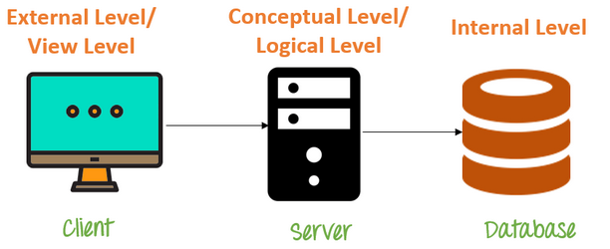
Levels of Abstraction
Database systems comprise of complex data structures. Thus, to make the system efficient for retrieval of data and reduce the complexity of the users, developers use the method of Data Abstraction.
There are mainly three levels of data abstraction:
Physical level: Actual PHYSICAL storage structure and access paths.
Logical Level: Structure and constraints for the entire database
External or View level: Describes various user views

Slide 29

3 Levels ANSI SPARC Database System
User 1
User 2
User 3
How data are viewed by each users?
View 1
View 2
View 3
View
Level
What data are stored and
What relationships exist?
Conceptual
Level
Logical
Level
How the data are actually stored on storage devices?
Internal
Level
Physical
Level
Database

Slide 30
3 Levels ANSI SPARC Database System
Internal level (Physical level)
It describes how a data is stored on the storage device.
Deals with physical storage of data.
Structure of records on disk - files, pages, blocks and indexes and ordering of records
Internal view is described by the internal schema.
Conceptual level (Logical level)
What data are stored and what relationships exist among those data?
It hides low level complexities of physical storage.
For Example, STUDENT database may contain STUDENT and COURSE tables which will be visible to users but users are unaware about their storage.
Database administrator works at this level to determine what data to keep in the database.
External level (View level)
It describes only part of the entire database that an end user concern or how data are viewed by each user.
Different user needs different views of the database, so there can be many views in a view level abstraction of the database. Used by end users and application programmers.
End users need to access only part of the database rather than the entire database.
It hides the unrelated details of the database from the user. There may be "n" number of external views for each database.

Slide 31
3 Levels ANSI SPARC Database System: Example
We are storing student information in a student table.
User 1
User 2
User 3
User just interact with system with the help of GUI.
Users are not aware of how and what the data is stored.
View 1
View 2
View 3
View
Level
Records can be described as fields and attributes along with their data types, their relationship among each other can be logically implemented.
Programmers generally work at this level.
Conceptual
Level
Logical
Level
Records can be described as blocks of storage (bytes, gigabytes, terabytes etc.) in memory.
These details are often hidden from the programmers.
Internal
Level
Physical
Level
Database

Slide 32
Data Abstraction in DBMS
Database systems are made-up of complex data structures.
To ease the user interaction with database, the developers hide internal irrelevant details from users.
This process of hiding irrelevant details from user is called data abstraction.

Slide 33
Instances and Schemas
Schema – the logical structure of the database
e.g., the database consists of information about a set of customers and accounts and the relationship between them)
A database schema is the skeleton structure of the database. It represents the logical view of the entire database.
A schema contains schema objects like table, foreign key, primary key, views, columns, data types, stored procedure, etc.
A database schema is designed by the database designers to help programmers whose software will interact with the database. The process of database creation is called data modeling.
Instance – the actual content of the database at a particular point in time
Analogous to the value of a variable(a row)

Slide 34
Data Independence
Data Independence is defined as a property of DBMS that helps you to change the Database schema at one level of a database system without requiring to change the schema at the next higher level. Data independence helps you to keep data separated from all programs that make use of it.

Slide 35
Types of Data Independence
Physical Data Independence
Physical Data Independence is the ability to modify the physical schema without requiring any change in logical (conceptual) schema and application programs.
Modifications at the internal levels are occasionally necessary to improve performance.
Possible modifications at internal levels are changes in file structures, compression techniques, hashing algorithms, storage devices, etc.
Logical Data Independence
Logical data independence is the ability to modify the conceptual schema without causing application program to be rewritten.
Modification at the logical levels is necessary whenever the logical structure of the database is changed.
Logical Data independence means if we add some new columns or remove some columns from table then the user view and programs should not change.
For example: consider two users A & B. Both are select the fields "EmployeeNumber" and "EmployeeName". If user B adds a new column (e.g. salary) to his table, it will not affect the external view for user A, though the internal schema of the database has been changed for both users A & B.
Application programs are heavily dependent on logical structures of the data they access. So any change in logical structure also requires programs to change.

Slide 36
Examples of changes under Physical Data Independence
Due to Physical independence, any of the below change will not affect the conceptual layer.
Using a new storage device like Hard Drive or Magnetic Tapes
Modifying the file organization technique in the Database
Switching to different data structures.
Changing the access method.
Modifying indexes.
Changes to compression techniques or hashing algorithms.
Change of Location of Database from say C drive to D Drive
Examples of changes under Logical Data Independence
Due to Logical independence, any of the below change will not affect the external layer.
Add/Modify/Delete a new attribute, entity or relationship is possible without a rewrite of existing application programs
Merging two records into one
Breaking an existing record into two or more records

Slide 37
Importance of Data Independence
Helps you to improve the quality of the data
Database system maintenance becomes affordable
Enforcement of standards and improvement in database security
You don't need to alter data structure in application programs
Permit developers to focus on the general structure of the Database rather than worrying about the internal implementation
It allows you to improve state which is undamaged or undivided
Database incongruity is vastly reduced.
Easily make modifications in the physical level is needed to improve the performance of the system.

Slide 38
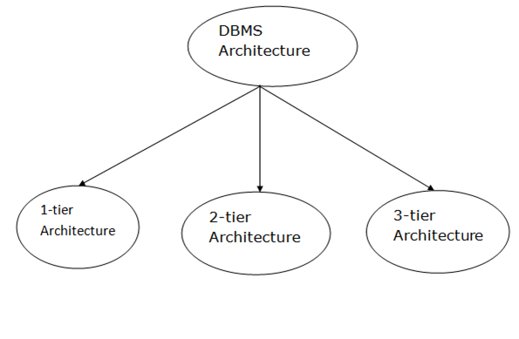
DBMS Architecture
The DBMS design depends upon its architecture. The basic client/server architecture is used to deal with a large number of PCs, web servers, database servers and other components that are connected with networks.
The client/server architecture consists of many PCs and a workstation which are connected via the network.
DBMS architecture depends upon how users are connected to the database to get their request done.

Slide 39
1-Tier Architecture
In this architecture, the database is directly available to the user. It means the user can directly sit on the DBMS and uses it.
Any changes done here will directly be done on the database itself. It doesn't provide a handy tool for end users.
The 1-Tier architecture is used for development of the local application, where programmers can directly communicate with the database for the quick response.(same system)
2-Tier Architecture
The 2-Tier architecture is same as basic client-server. In the two-tier architecture, applications on the client end can directly communicate with the database at the server side. For this interaction, API's like: ODBC, JDBC are used.
An application interface which is called ODBC (Open Database Connectivity) an API which allows the client-side program to call the DBMS.
Today most of the DBMS offers ODBC drivers for their DBMS.
2 tier architecture provides added security to the DBMS as it is not exposed to the end user directly.

Slide 40
3-Tier Architecture
The 3-Tier architecture contains another layer between the client and server. In this architecture, client can't directly communicate with the server.
The application on the client-end interacts with an application server which further communicates with the database system.
End user has no idea about the existence of the database beyond the application server. The database also has no idea about any other user beyond the application.(username password)
The 3-Tier architecture is used in case of large web application. (facebook, youtube,etc.)
**Application server will decide what to do with this request where to forward.

Slide 41
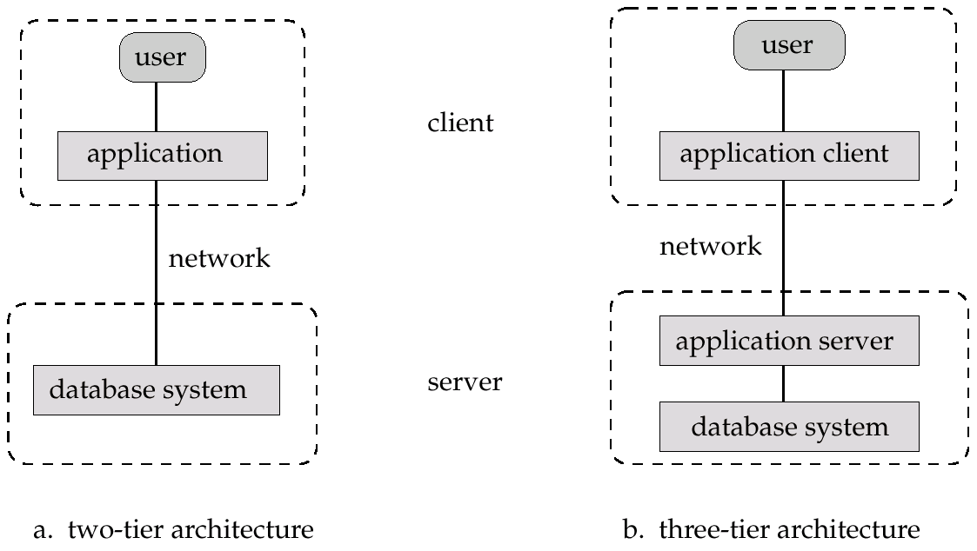
Architectures
Two-tier architecture: E.g. client programs using ODBC/JDBC to communicate with a database
Three-tier architecture: E.g. web-based applications, and applications built using “middleware”

Slide 42
Database System Architecture
Naive
user
Application programmer
Sophisticated
user
Database administrator
uses
write
uses
uses
Application
interfaces
Application
program
Query
tool
Administration tool
Translates DML statements into low level instructions that the query evaluation engine understands
Compiler and linker
DML queries
DDL interpreter
Interprets DDL statements into a set of tables containing metadata
Executes low level instructions generated by DML compiler.
Deals with execution of DDL and DML statements
Application program object code
DML compiler and organizer
Query evaluation engine
Query processor
Buffer manager
File manager
Authorization and integrity manager
Transaction manager
Manages allocation of space on disk storage
Storage manager
Fetches data from disk storage to memory for being used
Preserves atomicity and controls concurrency
Provides interface between low-level data stored and application program or queries
Checks the authority of users to access data and integrity constraints
To provide faster access to data items
Indices
Data dictionary
Disk storage
To store user data
Data
Statistical data
To store statistical information about the data
To store metadata

Slide 43
Types of Database Users
Section - 6

Slide 44
Types of Database Users
Naive Users (End Users)
Unsophisticated users who have zero knowledge of database system
End user interacts to database via sophisticated software or tools
e.g. Clerk in bank
Application Programmers
Programmers who write software using tools such as Java, .Net, PHP etc…
e.g. Software developers
Sophisticated Users
Interact with database system without using an application program
Use query tools like SQL
e.g. Analyst
Specialized Users (DBA)
User write specialized database applications program
Use administration tools
e.g. Database Administrator

Slide 45
Role of DBA (Database Administrator)
Section - 7

Slide 46
Role of DBA
Schema Definition
DBA defines the logical schema of the database.
Storage Structure and Access Method Definition
DBA decides how the data is to be represented in the database & how to access it.
Schema and physical-organization modification.
The DBA carries out changes to the schema and physical organization to reflect the changing needs of the organization, or to alter the physical organization to improve performance
Defining Security and Integrity Constraints
DBA decides on various security and integrity constraints.
Granting of Authorization for Data Access
DBA determines which user needs access to which part of the database.
Communication with Users
DBA provide necessary data to the user.

Slide 47
Role of DBA
Assisting Application Programmer
DBA provides assistance to application programmers to develop application programs.
Monitoring Performance
DBA ensures that better performance is maintained by making a change in the physical or logical schema if required.
Backup and Recovery
DBA backing up the database on some storage devices such as DVD, CD or magnetic tape or remote servers , Ensuring that enough free disk space is available for normal operations(and upgrading disk space as required.)and recover the system in case of failures, such as flood or virus attack from this backup.

Slide 48
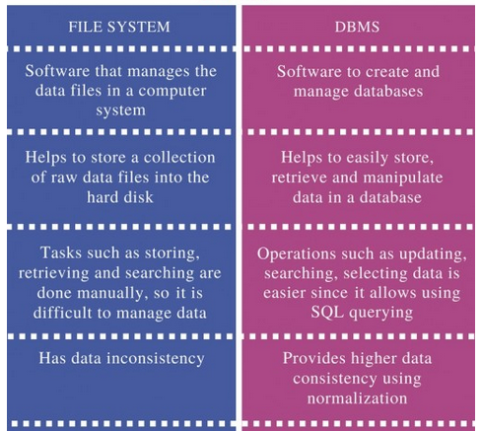
File system vs DBMS

Slide 49
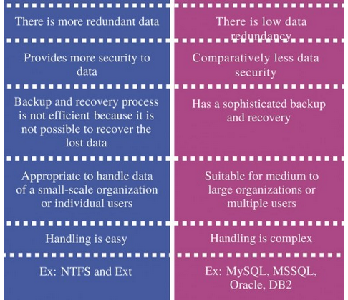

Slide 50
Data Models
A Database model defines the logical design and structure of a database.
Also defines how data will be stored, accessed and updated in a database management system.
It provides the conceptual tools for describing the design of a database at each level of data abstraction
Some data base models are:
Hierarchical Model
Network Model
Entity-relationship Model
Relational Mode
Other models:
object-oriented model
semi-structured data models

Slide 51
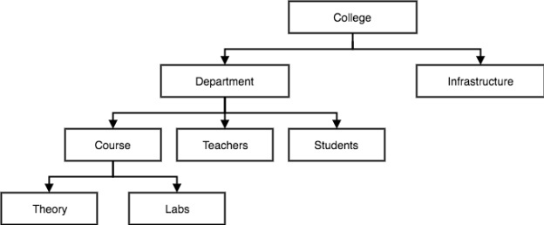
1. Hierarchical Model
This database model organises data into a tree-like-structure, with a single root, to which all the other data is linked.
The hierarchy starts from the Root data, and expands like a tree, adding child nodes to the parent nodes.
In hierarchical model, data is organised into tree-like structure with one one-to-many relationship between two different types of data, for example, one department can have many courses, many professors and of-course many students.

Slide 52
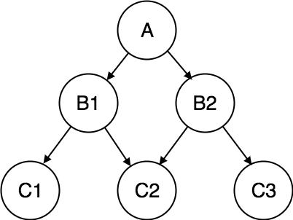
2. Network Model
This is an extension of the Hierarchical model. In this model data is organised more like a graph, and are allowed to have more than one parent node.
In this database model data is more related as more relationships are established in this database model. Also, as the data is more related, hence accessing the data is also easier and fast. This database model was used to map many-to-many data relationships.

Slide 53
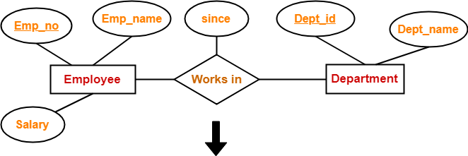
3. ER Model
In this database model, relationships are created by dividing object of interest into entity and its characteristics into attributes.
E-R Models are defined to represent the relationships into pictorial form to make it easier for different stakeholders to understand.
ER Model is based on −
Entities and their attributes.
Relationships among entities.

Slide 54
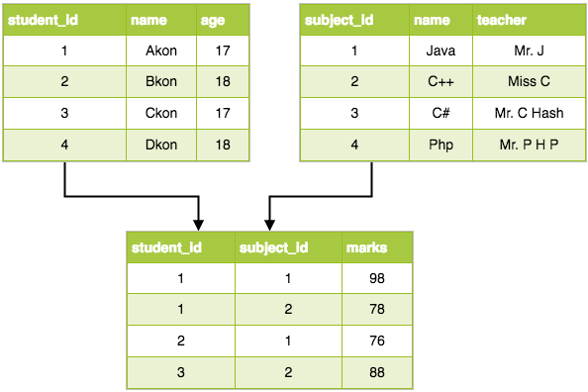
4. Relational Model
The relational model represents the database as a collection of relations.
A relation is nothing but a table of values. Every row in the table represents a collection of related data values.
These rows in the table denote a real-world entity or relationship.
The table name and column names are helpful to interpret the meaning of values in each row.
In the relational model, data are stored as tables. However, the physical storage of the data is independent of the way the data are logically organized.
Some popular relational DBMS are:-
Oracle
DB2
SQL Server and MS access

Slide 55
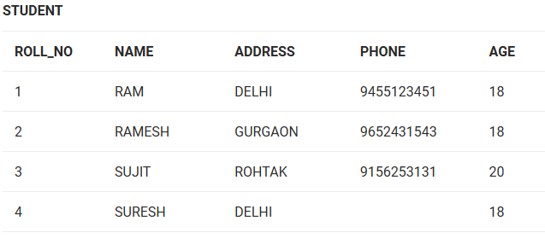
Consider a relation STUDENT with attributes ROLL_NO, NAME, ADDRESS, PHONE and AGE shown in Table 1.
Attribute: Attributes are the properties that define a relation. e.g.; ROLL_NO, NAME
Relation Schema: A relation schema represents name of the relation with its attributes. e.g.; STUDENT (ROLL_NO, NAME, ADDRESS, PHONE and AGE) is relation schema for STUDENT. If a schema has more than 1 relation, it is called Relational Schema.

Slide 56
Tuple: Each row in the relation is known as tuple. The above relation contains 4 tuples, one of which is shown as:
Relation Instance: The set of tuples of a relation at a particular instance of time is called as relation instance. Table 1 shows the relation instance of STUDENT at a particular time. It can change whenever there is insertion, deletion or updation in the database.
Degree: The number of attributes in the relation is known as degree of the relation. The STUDENT relation defined above has degree 5.
Cardinality: The number of tuples in a relation is known as cardinality. The STUDENT relation defined above has cardinality 4.
Column: Column represents the set of values for a particular attribute. The column ROLL_NO is extracted from relation STUDENT.
NULL Values: The value which is not known or unavailable is called NULL value. It is represented by blank space. e.g.; PHONE of STUDENT having ROLL_NO 4 is NULL.

Slide 57
Constraints in Relational Model
While designing Relational Model, we define some conditions which must hold for data present in database are called Constraints.
These constraints are checked before performing any operation (insertion, deletion and updation) in database. If there is a violation in any of constrains, operation will fail.
Domain Constraints: These are attribute level constraints. An attribute can only take values which lie inside the domain range. e.g,; If a constrains AGE>0 is applied on STUDENT relation, inserting negative value of AGE will result in failure.
Key Integrity: Every relation in the database should have atleast one set of attributes which defines a tuple uniquely. Those set of attributes is called key. e.g.; ROLL_NO in STUDENT is a key. No two students can have same roll number. So a key has two properties:
It should be unique for all tuples.
It can’t have NULL values.

Slide 58
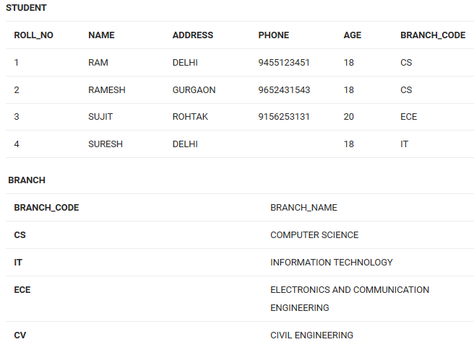
Referential Integrity
When one attribute of a relation can only take values from other attribute of same relation or any other relation, it is called referential integrity. Let us suppose we have 2 relations
BRANCH_CODE of STUDENT can only take the values which are present in BRANCH_CODE of BRANCH relation(table) which is called referential integrity constraint.

Slide 59
Relational Model
Attributes
Example of tabular data in the relational model
Customer-id
customer-
name
customer-
street
customer-
city
account-
number
192-83-7465
019-28-3746
192-83-7465
321-12-3123
019-28-3746
Johnson
Smith
Johnson
Jones
Smith
Alma
North
Alma
Main
North
Palo Alto
Rye
Palo Alto
Harrison
Rye
A-101
A-215
A-201
A-217
A-201

Slide 60
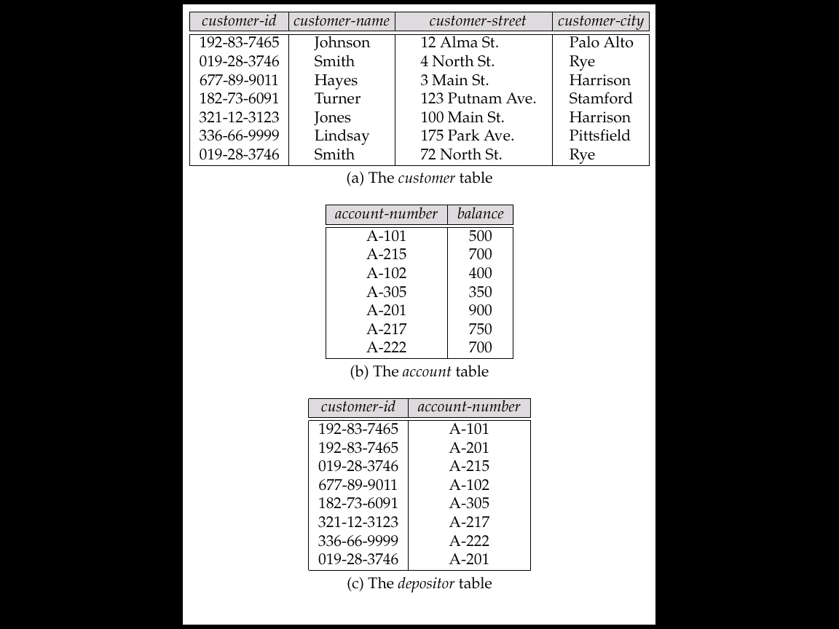
A Sample Relational Database

Slide 61
SQL
SQL stands for Structured Query language, pronounced as "S-Q-L" or sometimes as "See-Quel".
SQL is the standard language for dealing with Relational Databases.
SQL can be used to insert, search, update and delete database records.
SQL can do lots of other operations including optimizing and maintenance of databases. Relational databases like MySQL Database, Oracle, Ms SQL server, Sybase, etc uses SQL.
How to use sql syntaxes?
SQL Example
SELECT * FROM Members WHERE Age > 30
SQL syntaxes used in these databases are almost similar, except the fact that some are using few different syntaxes and even proprietary SQL syntaxes.

Slide 62
SQL Commands
The standard SQL commands to interact with relational databases are CREATE, SELECT, INSERT, UPDATE, DELETE and DROP. These commands can be classified into the following groups based on their nature −
DDL - Data Definition Language
1 CREATE: Creates a new table, a view of a table, or other object in the database.
2 ALTER : Modifies an existing database object, such as a table.
3 DROP :Deletes an entire table, a view of a table or other objects in the database.
DML - Data Manipulation Language
1 SELECT :Retrieves certain records from one or more tables.
2 INSERT :Creates a record.
3 UPDATE :Modifies records.
4 DELETE :Deletes records.
DCL - Data Control Language
1 GRANT :Gives a privilege to user.
2 REVOKE :Takes back privileges granted from user.

Slide 63
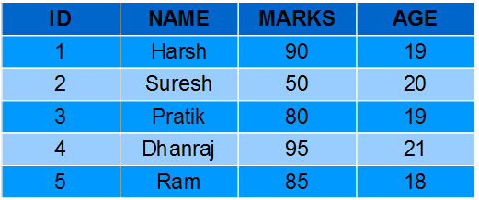
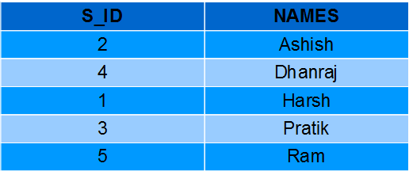
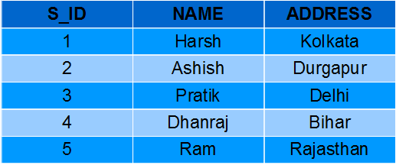
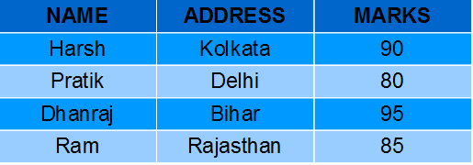
SQL Views
Views in SQL are kind of virtual tables.
A view also has rows and columns as they are in a real table in the database.
We can create a view by selecting fields from one or more tables present in the database.
A View can either have all the rows of a table or specific rows based on certain condition.

